Slide 1
CITY OF STAMFORD OFFICE OF THE ASSESSOR Greg Stackpole, CCMA II Assessor (203) 977-4018 GStackpole@StamfordCT.gov MARCH 13, 2024

Slide 2
Department Introduction & Brief History
Department’s Mission: To maintain and defend an equitable tax base and appraisal of all real and personal property business assets and motor vehicles within the City of Stamford, for the inclusion onto the annual Grand List; including all State and local tax exemptions and elderly tax benefits for eligible recipients. The Grand List represents the total assessed value for all taxable and exempt property located within the City on October 1, in accordance with Section 12-62a of the Connecticut General Statutes.

Slide 3
Department Org. Chart
Director of Administration
Deputy Assessor
Assessor
Assessment Inspector
Personal Property Inspector (2)
Commercial Appraiser (2)
Board of Assessment Appeals
Property Revaluation
Account Clerk (2)
Income and Expense Analyst
Tax Exempt Coordinator (2)
Commercial and Residential Analyst

Slide 4
What are the most significant accomplishments made & challenges faced by the department in the last FY 2023-2024.
Accomplishments:
Personal Property Business Audit Program collected $568K with 400% ROI.
Motor Vehicle Compliance Program
Added 867 vehicles to tax rolls.
$10,964,385 in Assessment
**(Contract year: 1/23 -1/25)**
Challenges:
Continued increases in cost for access to JD Power/ NADA Guides required for the pricing of motor vehicles.

Slide 5
FY 2024-2025 Goals
What are your department goals and plans for 2024-2025
What is the Department’s/Program’s budget? (highlight changes)
Departmental costs are minimal other than salary – budget has remained LEAN– contracted services - 1026 (Property Reval) was reduced by 52,000 (originally budgeted for arial photography) and reallocated for a seasonal position to assist with the Board of Assessment Appeals, Commercial Multiple Listing Service (CoStar) and additional cost for NADA guides/Lookups used to value Motor Vehicles.

Slide 6
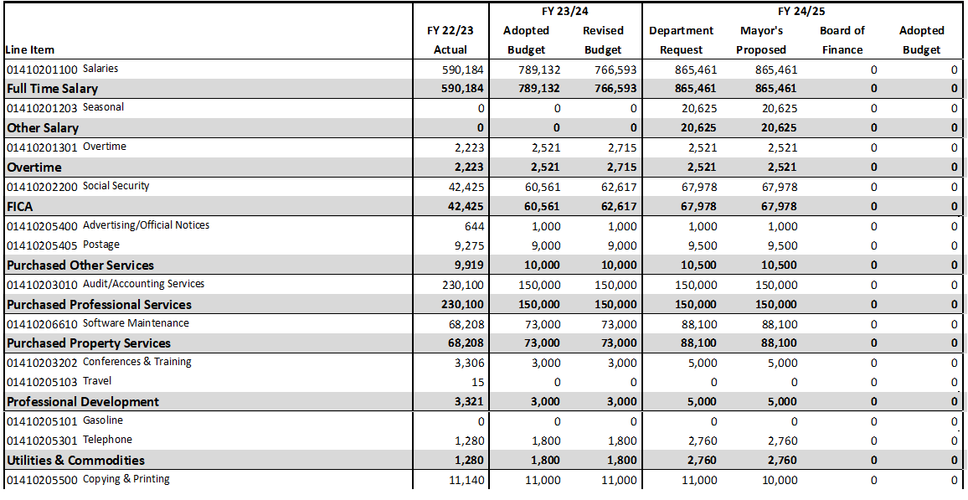

Slide 7
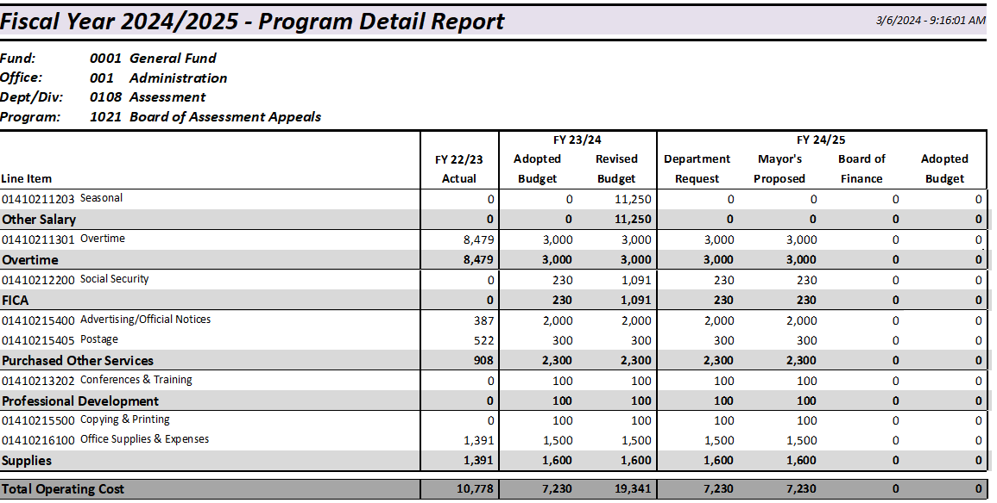

Slide 8
