Slide 1
CITY OF STAMFORD BUILDING DEPARTMENT Shawn Reed sreed@stamfordct.gov April 2, 2024

Slide 2
Board Of Finance - PPT Requirements
1. Staffing Updates- There are no new additions or deletions. All upcoming pay increases are from the approved contract negotiations.
3. There are no requested budget increases.
4. I believe we are currently at the base budget level for our ability to provide the needed customer service?

Slide 3
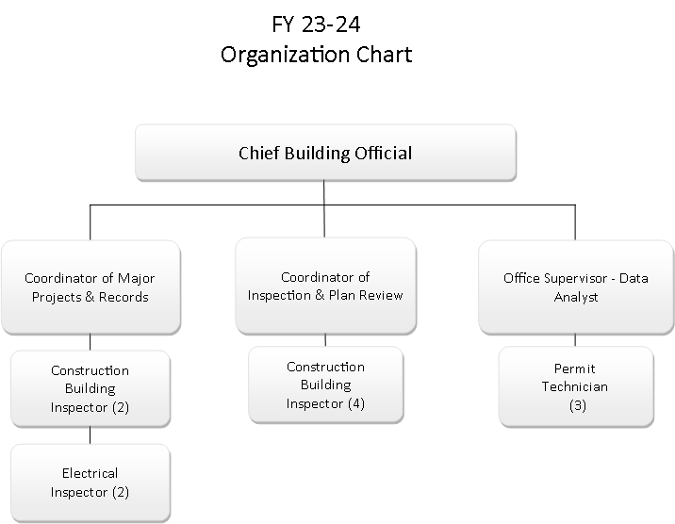
Department Org. Chart

